Slide 1
Sampling Based Inference
Il-Chul Moon Dept. of Industrial and Systems Engineering KAIST
icmoon@kaist.ac.kr

Slide 2
Weekly Objectives
Learn sampling based inference method
Understand the concept of Markov chain Monte Carlo
Able to apply MCMC to the parameter inference of Bayesian networks
Know the mechanism of rejection sampling
Know the mechanism of Gibbs sampling
Know a case study of sampling based inference
Understand the latent Dirichlet allocation model
Know the collapsed Gibbs sampling
Know how to derive Gibbs sampling formula for LDA

Slide 3
Sampling based inference

Slide 4
Forward Sampling
Generate a sample from the Bayesian network
Follow topological order
Buglary → false
Earthquake → false
Alarm|B=F,E=F→true
JC|A=T→true
MC|A=T→false
Create such sample many, many, many times
Then, count the samples match the case
P(E=T|MC=T)=?
Count the cases of E=T and MC=T
Count the cases of MC=T
Any problem?
P(B)=0.001
P(E)=0.002
Buglary
Earthquake
Alarm
JohnCalls
MaryCalls
A | P(J|A)
T | 0.90
F | 0.05
B | E | P(A|B,E)
T | T | 0.95
T | F | 0.94
F | T | 0.29
F | F | 0.001
A | P(M|A)
T | 0.70
F | 0.01

Slide 5


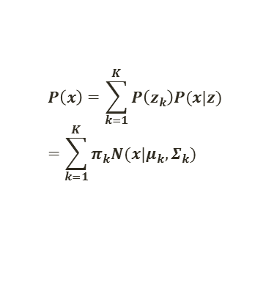


Forward Sampling in GMM
$$P\left(x\right)=\sum_{k=1}^{K}{P\left(z_{k}\right)P(x|z) }=\sum_{k=1}^{K}{π_{k}N(x|μ_{k},Σ_{k})}$$
Forward sampling of GMM
Sample z from $π$
z is the indicator of the mixture distribution
With selected z, sample x from $N(μ_{z},Σ_{z})$
After many, many sampling, you can draw the histogram of the mixture distribution
You have an empirical PDF, so you can ask a query like $P(0≤x≤\text{5|}π,μ,Σ)$
$$π$$
z
$$μ$$
$$Σ$$
x
N

Slide 6
Rejection Sampling
P(E=T|MC=T,A=F)=?
RejectionSampling
Iterate many times
Generate a sample from the Bayesian network
Buglary → false
Earthquake → false
Alarm|B=F,E=F→true
If the sample does not follow MC=T, A=F, reject the sampling procedure, and repeat
JC|A=T→true
MC|A=T→false
Return Count(E=T,MC=T,A=F)/# of Samples
Any problem?
P(B)=0.001
P(E)=0.002
Buglary
Earthquake
Alarm
JohnCalls
MaryCalls
A | P(J|A)
T | 0.90
F | 0.05
B | E | P(A|B,E)
T | T | 0.95
T | F | 0.94
F | T | 0.29
F | F | 0.001
A | P(M|A)
T | 0.70
F | 0.01

Slide 7

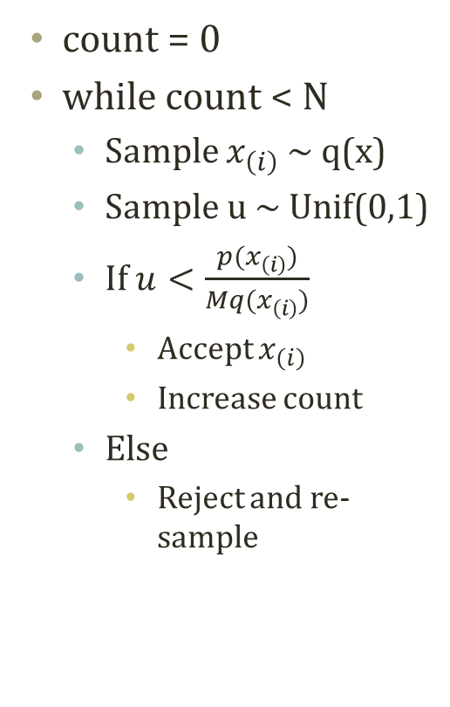



Rejection Sampling from Numerical View
샘플링하기 쉬운 분포 (모든 x에 대해서 Mq(x)가 p(x)의 위에 있도록 M을 정해야 한다. )
count = 0
while count < N
Sample $x_{\left(i\right)}$ ~ q(x)
Sample u ~ Unif(0,1)
If $u<\frac{p(x_{\left(i\right)})}{Mq(x_{\left(i\right)})}$
Accept $x_{\left(i\right)}$
Increase count
Else
Reject and re-sample
p(x), q(x)
$$\text{Mq}\text{(}x_{\left(i\right)})$$
기각 영역
$$p(x_{\left(i\right)})$$
샘플링하기 어려운 분포
$$\text{uMq}\text{(}x_{\left(i\right)})$$
q(x)
채택 영역
p(x)
$x_{\left(i\right)}$ ~ q(x)
x

Slide 8
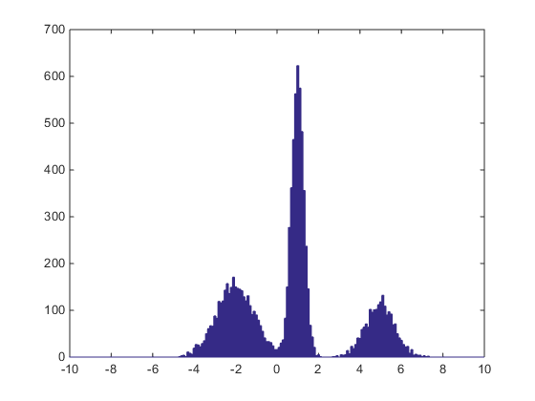
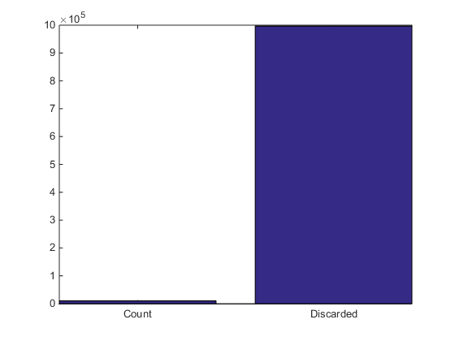
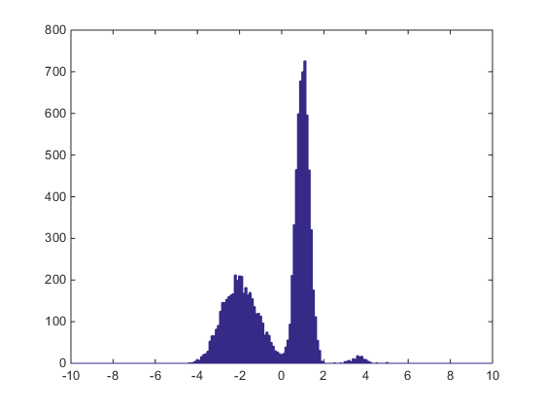
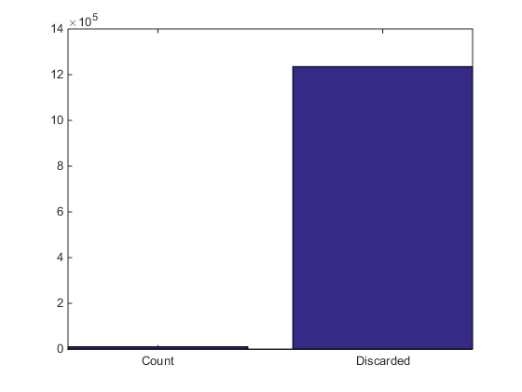

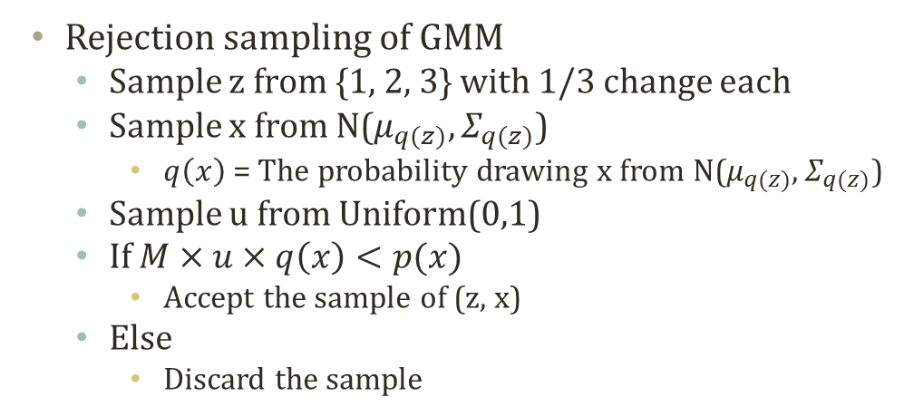


Rejection Sampling in GMM
$$P\left(x\right)=\sum_{k=1}^{K}{P\left(z_{k}\right)P(x|z) }=\sum_{k=1}^{K}{π_{k}N(x|μ_{k},Σ_{k})}$$
$$π$$
Rejection sampling of GMM
Sample z from {1, 2, 3} with 1/3 change each
Sample x from N($μ_{q(z)},Σ_{q(z)}$)
$q\left(x\right)$ = The probability drawing x from N($μ_{q(z)},Σ_{q(z)}$)
Sample u from Uniform(0,1)
If $M×u×q\left(x\right)<p(x)$
Accept the sample of (z, x)
Else
Discard the sample
z
$$μ$$
$$Σ$$
x
N
P Mixture = 0.35*N(-2,0.9),
0.45*N(1,0.3),
0.2*N(5,0.8)
Q Mixture = 1/3*N(-2,1), 1/3*N(1,1), 1/3*N(5,1)
Q Mixture = 3 * ( 1/3 * N(0,1) )

Slide 9
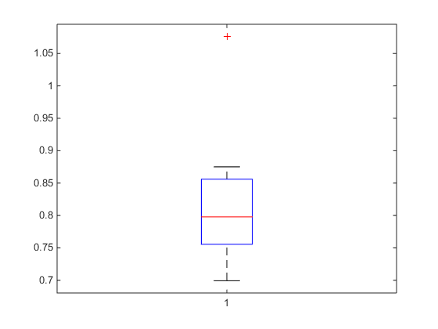
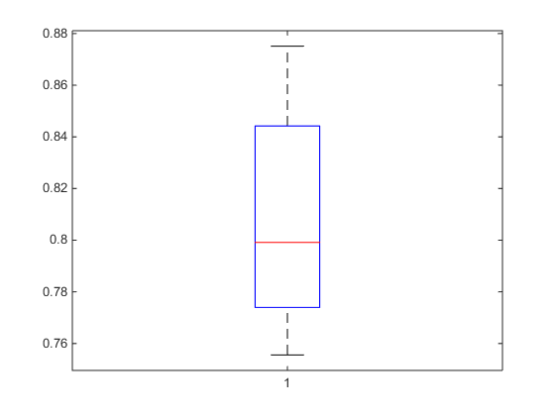
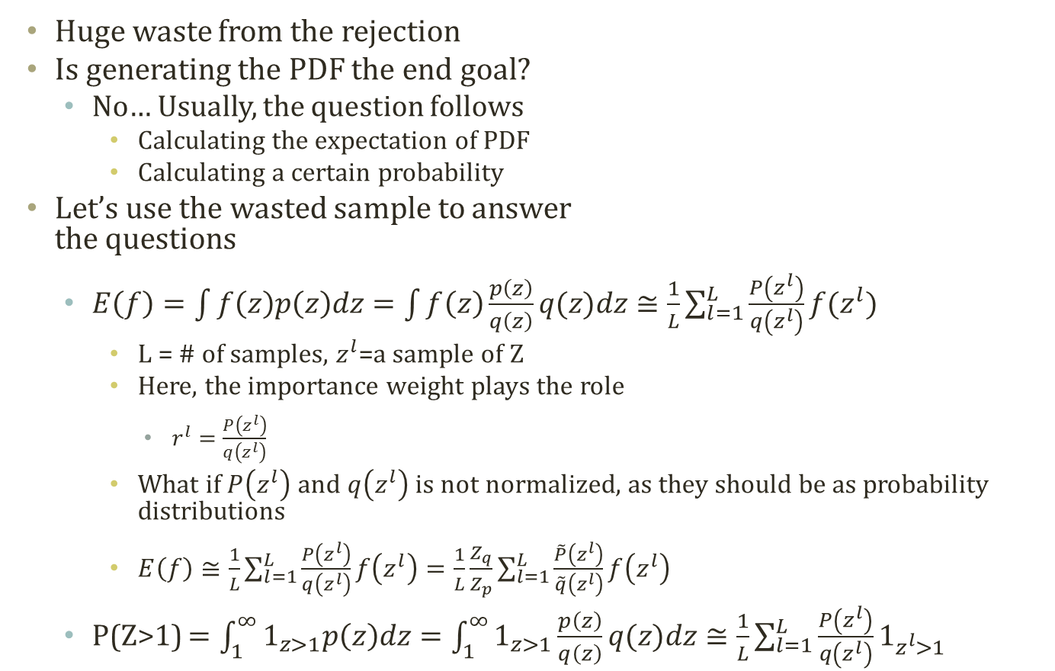
Importance Sampling
Importance Sampling Prone to Extreme Values
Huge waste from the rejection
Is generating the PDF the end goal?
No… Usually, the question follows
Calculating the expectation of PDF
Calculating a certain probability
Let’s use the wasted sample to answer the questions
$E\left(f\right)=\int{f\left(z\right)p\left(z\right)dz}=\int{f\left(z\right)\frac{p\left(z\right)}{q\left(z\right)}q(z)dz}≅\frac{1}{L}\sum_{l=1}^{L}{\frac{P\left(z^{l}\right)}{q\left(z^{l}\right)}f(z^{l})}$
L = # of samples, $z^{l}$=a sample of Z
Here, the importance weight plays the role
$r^{l}=\frac{P\left(z^{l}\right)}{q\left(z^{l}\right)}$
What if $P\left(z^{l}\right)$ and $q\left(z^{l}\right)$ is not normalized, as they should be as probability distributions
$E\left(f\right)≅\frac{1}{L}\sum_{l=1}^{L}{\frac{P\left(z^{l}\right)}{q\left(z^{l}\right)}f\left(z^{l}\right)}=\frac{1}{L}\frac{Z_{q}}{Z_{p}}\sum_{l=1}^{L}{\frac{\tilde{P}\left(z^{l}\right)}{\tilde{q}\left(z^{l}\right)}f\left(z^{l}\right)}$
P(Z>1) $=\int_{1}^{∞}{1_{z>1}p\left(z\right)dz}=\int_{1}^{∞}{1_{z>1}\frac{p\left(z\right)}{q\left(z\right)}q(z)dz}≅\frac{1}{L}\sum_{l=1}^{L}{\frac{P\left(z^{l}\right)}{q\left(z^{l}\right)}1_{z^{l}>1}}$
Filtered Extreme Values

Slide 10
Likelihood Weighting Algorithm
P(E=T|MC=T,A=F)=?
LikelihoodWeighting
SumSW=NormSW=0
Iterate many times
SW=SampleWeight = 1
Generate a sample from the Bayesian network
Buglary → false
Earthquake → false
Alarm=F|B=F,E=F
P(A=F|B=F,E=F)=0.999
SW=1*0.999
JC|A=T→true
MC=T|A=F
P(MC=T|A=F)=0.01
SW=1*0.999*0.01
If the sample has E=T, then SumSW+=SW
NormSW+=SW
Return SumSW/NormSW
Any further improvement?
These samples are….
P(B)=0.001
P(E)=0.002
Buglary
Earthquake
Alarm
JohnCalls
MaryCalls
A | P(J|A)
T | 0.90
F | 0.05
B | E | P(A|B,E)
T | T | 0.95
T | F | 0.94
F | T | 0.29
F | F | 0.001
A | P(M|A)
T | 0.70
F | 0.01

Slide 11
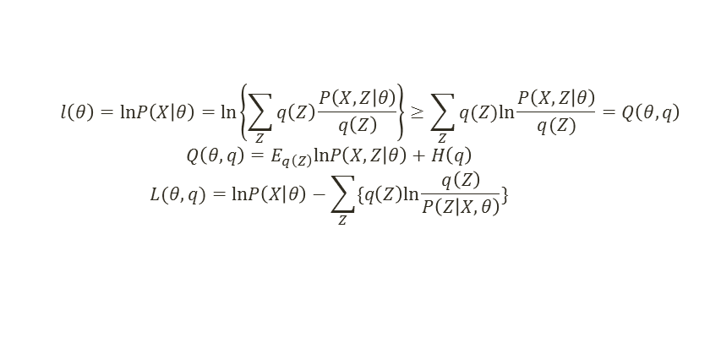
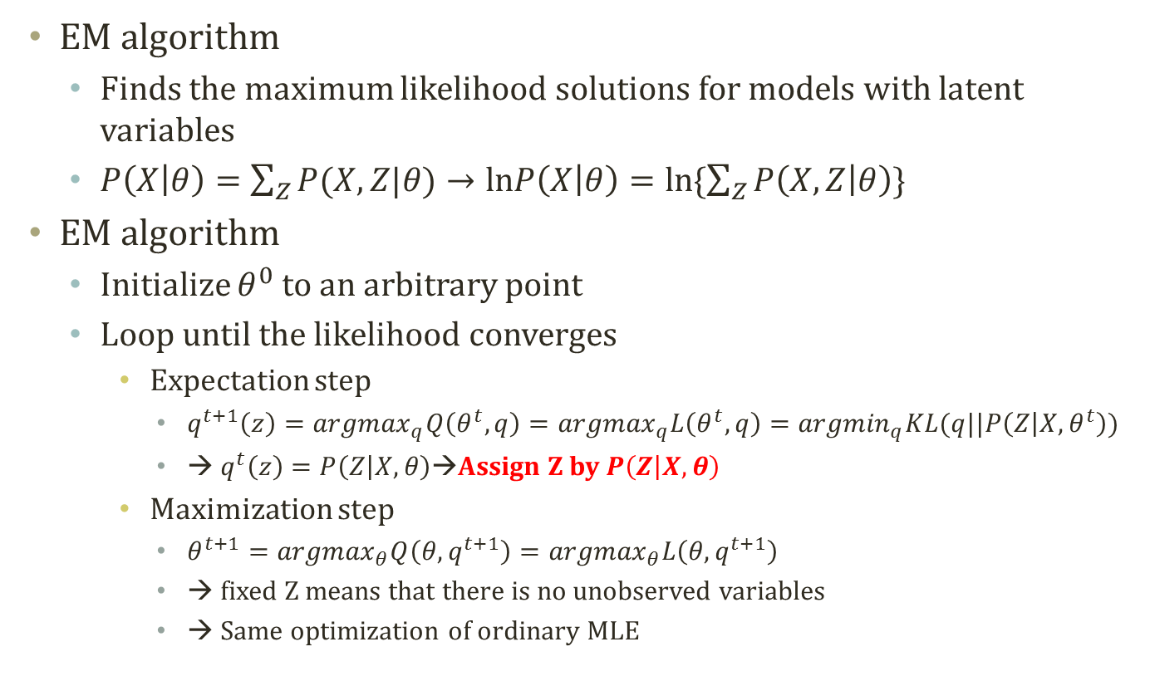
Detour: EM Algorithm
$$l\left(θ\right)=lnP\left(X | θ\right)=ln\left\{\sum_{Z}{q\left(Z\right)\frac{P\left(X,Z | θ\right)}{q\left(Z\right)}}\right\}≥\sum_{Z}{q(Z)ln\frac{P\left(X,Z | θ\right)}{q(Z)}}=Q\left(θ,q\right)$$
$$Q\left(θ,q\right)=E_{q\left(Z\right)}lnP\left(X,Z | θ\right)+H\left(q\right)$$
$$L(θ,q)=lnP\left(X | θ\right)−\sum_{Z}{\{q\left(Z\right)ln\frac{q\left(Z\right)}{P\left(Z | X,θ\right)}\}}$$
EM algorithm
Finds the maximum likelihood solutions for models with latent variables
$P\left(X | θ\right)=\sum_{Z}{P(X,Z|θ)}→lnP\left(X | θ\right)=ln\{\sum_{Z}{P\left(X,Z | θ\right)}\}$
EM algorithm
Initialize $θ^{0}$ to an arbitrary point
Loop until the likelihood converges
Expectation step
$q^{t+1}\left(z\right)={argmax}_{q}Q\left(θ^{t},q\right)={argmax}_{q}L\left(θ^{t},q\right)={argmin}_{q}KL(q||P\left(Z | X,θ^{t}\right))$
→ $q^{t}\left(z\right)=P\left(Z | X,θ\right)$→Assign Z by $P\left(Z | X,θ\right)$
Maximization step
$θ^{t+1}={argmax}_{θ}Q\left(θ,q^{t+1}\right)={argmax}_{θ}L\left(θ,q^{t+1}\right)$
→ fixed Z means that there is no unobserved variables
→ Same optimization of ordinary MLE
Computing Expectation….
Sometimes, it can be hard

Slide 12


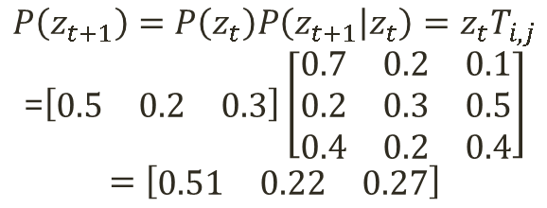
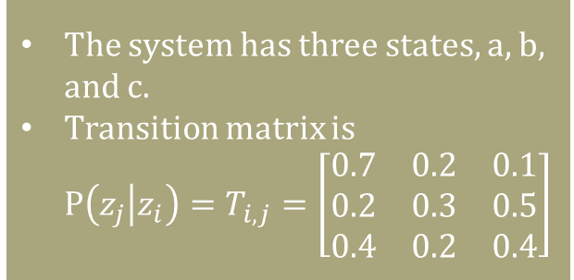

Detour: Markov Chain
Markov chain
Each node has a probability distribution of states
i.e.) The probability that a state is the current state of a system
Concrete observation of a system: [1 0 0] → the system is at the first state
Stochastic observation of a system: [0.7 0.2 0.1] → the system is likely at the first state
The node has a vector of state probability distribution
Each link suggests a probabilistic state transition
If a system is at the first state, the probability distribution of the next state is [0.3 0.4 0.3]
The link has a matrix of state transition probability distribution.
$$z_{t}=\left[\begin{matrix}0.5 & 0.2 & 0.3\end{matrix}\right]$$
$$z_{t}$$
$$z_{t+1}$$
The system has three states, a, b, and c.
Transition matrix is $P\left(z_{j} | z_{i}\right)=T_{i,j}=\left[\begin{matrix}\begin{matrix}0.7 \\ 0.2 \\ 0.4\end{matrix} & \begin{matrix}0.2 \\ 0.3 \\ 0.2\end{matrix} & \begin{matrix}0.1 \\ 0.5 \\ 0.4\end{matrix}\end{matrix}\right]$
$$P\left(z_{t+1}\right)=P\left(z_{t}\right)P\left(z_{t+1} | z_{t}\right)=z_{t}T_{i,j}$$
=$\left[\begin{matrix}0.5 & 0.2 & 0.3\end{matrix}\right]\left[\begin{matrix}\begin{matrix}0.7 \\ 0.2 \\ 0.4\end{matrix} & \begin{matrix}0.2 \\ 0.3 \\ 0.2\end{matrix} & \begin{matrix}0.1 \\ 0.5 \\ 0.4\end{matrix}\end{matrix}\right]$ $$=\left[\begin{matrix}0.51 & 0.22 & 0.27\end{matrix}\right]$$

Slide 13
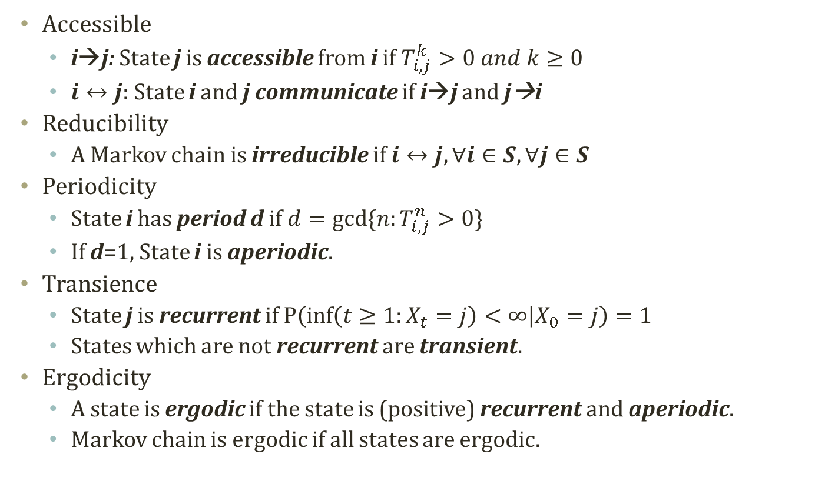
Detour: Properties of Markov Chain
Accessible
i→j: State j is accessible from i if $T_{i,j}^{k}>0 and k≥0$
$i↔j$: State i and j communicate if i→j and j→i
Reducibility
A Markov chain is irreducible if $i↔j, ∀i∈S,∀j∈S$
Periodicity
State i has period d if $d=gcd⁡\{n:T_{i,j}^{n}>0\}$
If d=1, State i is aperiodic.
Transience
State j is recurrent if $P\left(\inf\left(t≥1:X_{t}=j\right)<∞ | X_{0}=j\right)=1$
States which are not recurrent are transient.
Ergodicity
A state is ergodic if the state is (positive) recurrent and aperiodic.
Markov chain is ergodic if all states are ergodic.

Slide 14
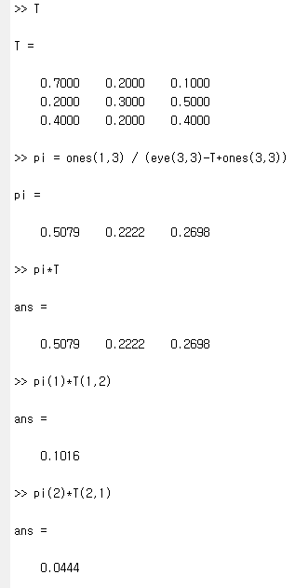
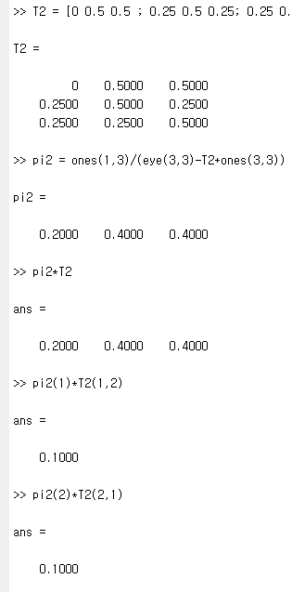

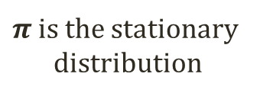
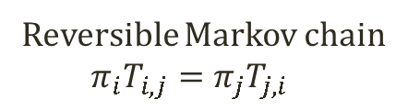
Detour: Stationary Distribution
${RT}_{i}=min⁡\{n>0:X_{n}=i|X_{0}=i\}$
Return time to state i after the departure from state i
Limit theorem of Markov chain
A friend in ISE dept. told me…..
If a Markov chain is irreducible and ergodic
$π_{i}=\lim_{n→∞}{T_{i,j}^{(n)}}=\frac{1}{E[{RT}_{i}]}$
$π_{i}$ is uniquely determined by the set of equations
$π_{i}≥0,\sum_{i∈S}{π_{i}}=1,π_{j}=\sum_{i∈S}{π_{i}T_{i,j}}$
How to compute $π$ given $T$
$π\left(I_{\left|S\right|,\left|S\right|}−T+1_{\left|S\right|,\left|S\right|}\right)=1_{1,|S|}$
$π_{j}=\sum_{i∈S}{π_{i}T_{i,j}}→π_{j}−\sum_{i∈S}{π_{i}T_{i,j}}=0→π\left(I_{\left|S\right|,\left|S\right|}−T\right)=0$
To the above formula, apply $\sum_{i∈S}{π_{i}}=1→π1_{\left|S\right|,\left|S\right|}=1_{1,|S|}$ to both sides
$π\left(I_{\left|S\right|,\left|S\right|}−T+1_{\left|S\right|,\left|S\right|}\right)=1_{1,|S|}$
Here, $π$ is the stationary distribution!
Reversible MC
Irreversible MC
$π$ is the stationary distribution
Reversible Markov chain
$$π_{i}T_{i,j}=π_{j}T_{j,i}$$
Detailed Balance, or Balance Equation

Slide 15

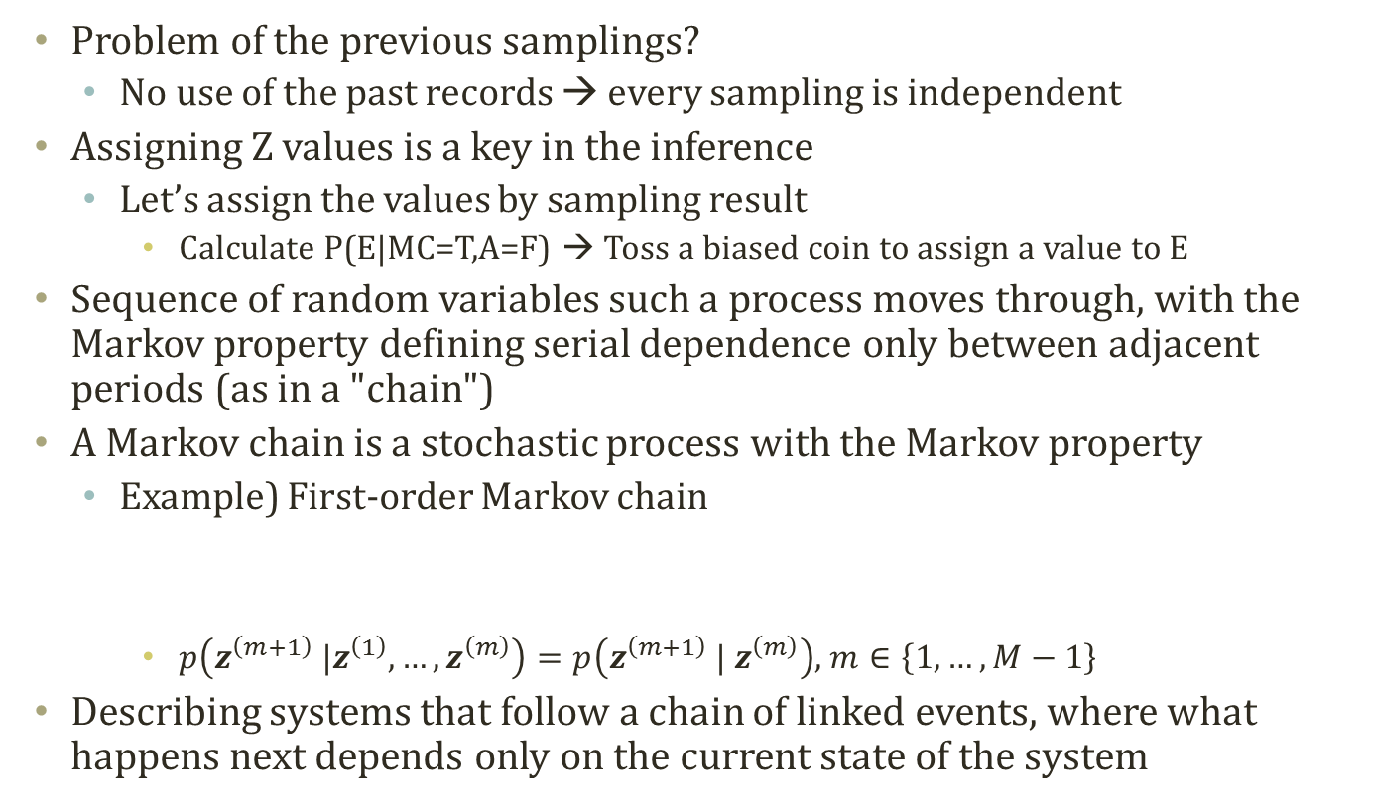



Markov Chain for Sampling
Problem of the previous samplings?
No use of the past records → every sampling is independent
Assigning Z values is a key in the inference
Let’s assign the values by sampling result
Calculate P(E|MC=T,A=F) → Toss a biased coin to assign a value to E
Sequence of random variables such a process moves through, with the Markov property defining serial dependence only between adjacent periods (as in a "chain")
A Markov chain is a stochastic process with the Markov property
Example) First-order Markov chain
$p\left(z^{\left(m+1\right)} |z^{\left(1\right)},…,z^{\left(m\right)}\right)=p\left(z^{\left(m+1\right)} | z^{\left(m\right)}\right)$, $m∈\left\{1,…,M−1\right\}$
Describing systems that follow a chain of linked events, where what happens next depends only on the current state of the system
$$z_{1}$$
$$z_{2}$$
$$z_{3}$$
$$z_{4}$$

Slide 16
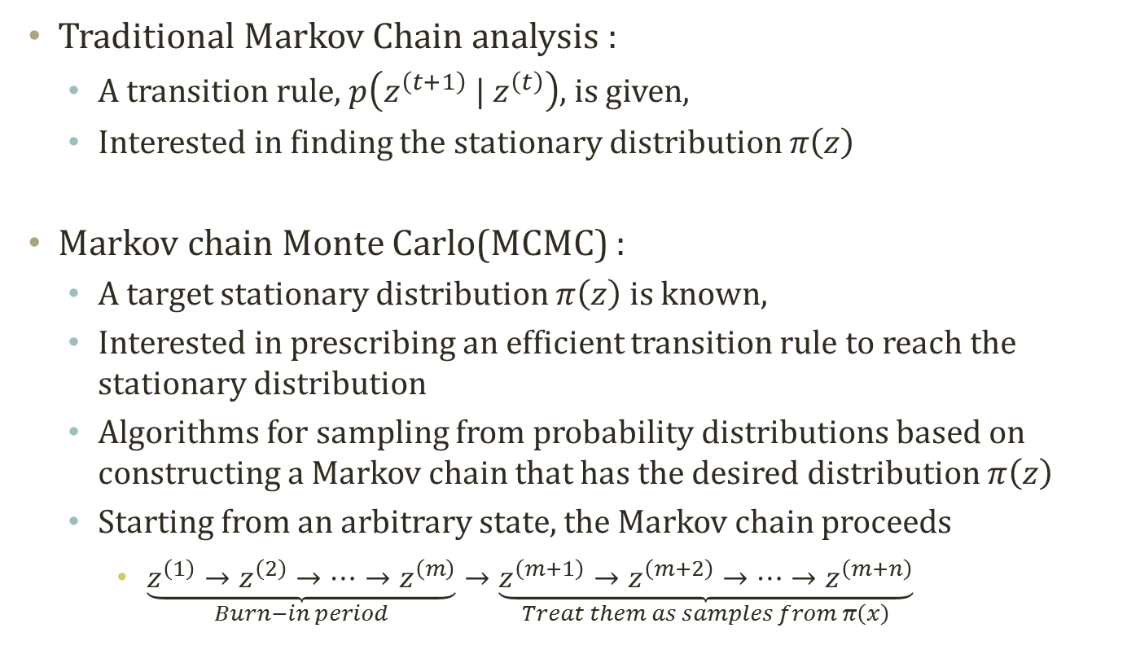




Markov chain theory vs. Markov Chain Monte Carlo
Traditional Markov Chain analysis :
A transition rule, $p\left(z^{\left(t+1\right)} | z^{\left(t\right)}\right)$, is given,
Interested in finding the stationary distribution $π\left(z\right)$
Markov chain Monte Carlo(MCMC) :
A target stationary distribution $π\left(z\right)$ is known,
Interested in prescribing an efficient transition rule to reach the stationary distribution
Algorithms for sampling from probability distributions based on constructing a Markov chain that has the desired distribution $π\left(z\right)$
Starting from an arbitrary state, the Markov chain proceeds
$\underset{Burn−in period}{\underbrace{z^{\left(1\right)}→z^{\left(2\right)}→⋯→z^{\left(m\right)}}}→\underset{Treat them as samples from π\left(x\right)}{\underbrace{z^{\left(m+1\right)}→z^{\left(m+2\right)}→⋯→z^{\left(m+n\right)}}}$
$$z_{1}$$
$$z_{2}$$
$$z_{3}$$
$$z_{4}$$
slides adopted from Prof. Park Tae Young’s
Notes:
Since convergence usually occurs regardless of our starting point, we can usually pick any feasible (for example, picking starting draws that are in the parameter space) starting point. However, the time it takes for the chain to converge varies depending on the starting point.
As a matter of practice, most people throw out a certain number of the ﬁrst draws, known as the burn-in. This is to make our draws closer to the stationary distribution and less dependent on the starting point. However, it is unclear how much we should burn-in since our draws are all slightly dependent and we don’t know exactly when convergence occurs.

Slide 17
Markov Chain of Z
Buglary
Earthquake
Buglary
Earthquake
Alarm
Alarm
JohnCalls
MaryCalls
JohnCalls
MaryCalls
Buglary
Earthquake
Buglary
Earthquake
Alarm
Alarm
JohnCalls
MaryCalls
JohnCalls
MaryCalls

Slide 18
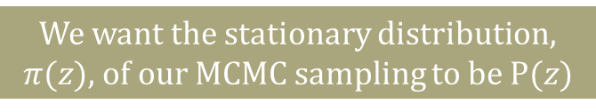
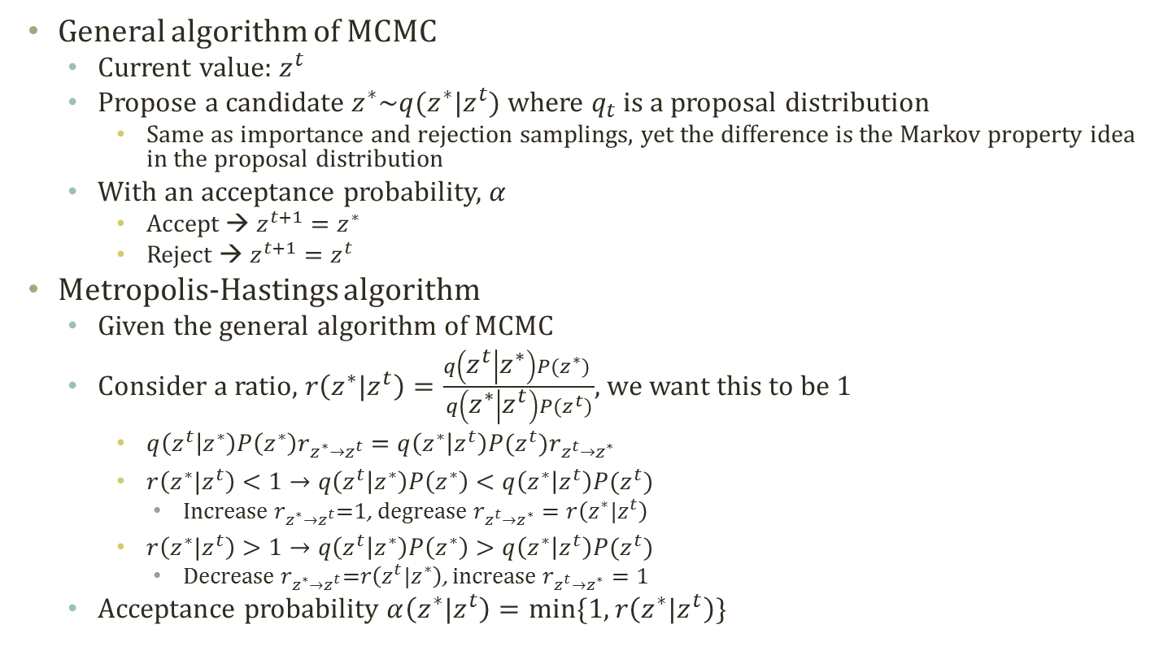

Metropolis-Hastings Algorithm
$q\left(z^{t} | z^{∗}\right)P\left(z^{∗}\right)<q\left(z^{∗} | z^{t}\right)P(z^{t})$→Movement from $z^{t}$ to $z^{∗}$ is too often
We want the stationary distribution, $π(z)$, of our MCMC sampling to be $P(z)$
General algorithm of MCMC
Current value: $z^{t}$
Propose a candidate $z^{∗}\sim q(z^{∗}|z^{t})$ where $q_{t}$ is a proposal distribution
Same as importance and rejection samplings, yet the difference is the Markov property idea in the proposal distribution
With an acceptance probability, $α$
Accept → $z^{t+1}=z^{∗}$
Reject → $z^{t+1}=z^{t}$
Metropolis-Hastings algorithm
Given the general algorithm of MCMC
Consider a ratio, $r\left(z^{∗}|z^{t}\right)=\frac{q\left(z^{t} | z^{∗}\right)P(z^{∗}) }{q\left(z^{∗} | z^{t}\right)P(z^{t})}$, we want this to be 1
$q\left(z^{t} | z^{∗}\right)P\left(z^{∗}\right)r_{z^{∗}→z^{t}}=q\left(z^{∗} | z^{t}\right)P(z^{t})r_{z^{t}→z^{∗}}$
$r\left(z^{∗}|z^{t}\right)<1→q\left(z^{t} | z^{∗}\right)P\left(z^{∗}\right)<q\left(z^{∗} | z^{t}\right)P(z^{t})$
Increase $r_{z^{∗}→z^{t}}$=1, degrease $r_{z^{t}→z^{∗}}=r\left(z^{∗}|z^{t}\right)$
$r\left(z^{∗}|z^{t}\right)>1→q\left(z^{t} | z^{∗}\right)P\left(z^{∗}\right)>q\left(z^{∗} | z^{t}\right)P(z^{t})$
Decrease $r_{z^{∗}→z^{t}}$=$r\left(z^{t}|z^{∗}\right)$, increase $r_{z^{t}→z^{∗}}=1$
Acceptance probability $α\left(z^{∗}|z^{t}\right)=min⁡\{1,r\left(z^{∗}|z^{t}\right)\}$
Reversible Markov chain
$$π_{i}T_{i,j}=π_{j}T_{j,i}$$
q is not well-designed to be the reversible MC, so we adjust by r

Slide 19

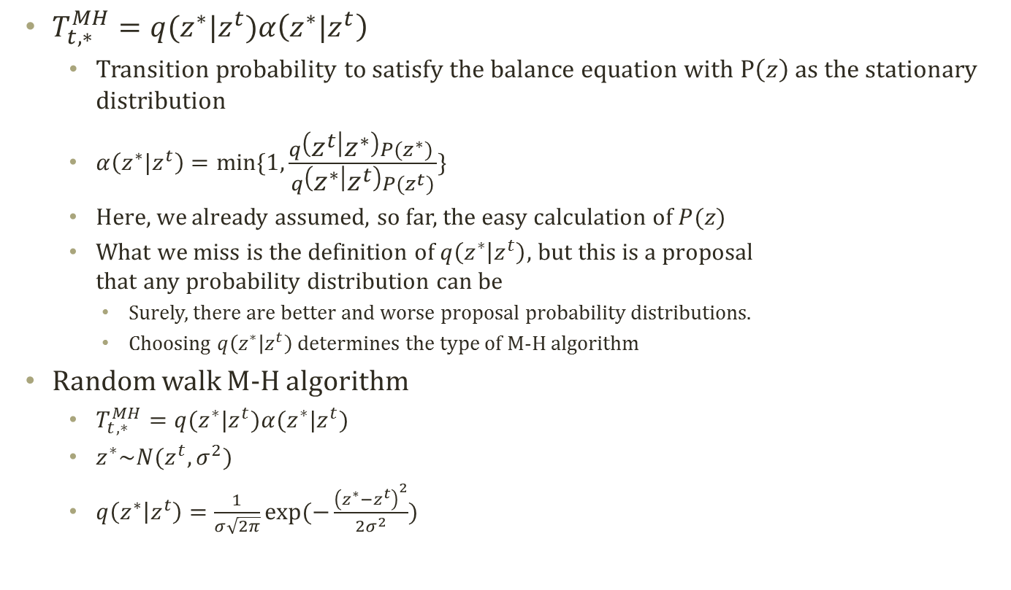



Random Walk M-H Algorithm
$T_{t,∗}^{MH}=q(z^{∗}|z^{t})α\left(z^{∗}|z^{t}\right)$
Transition probability to satisfy the balance equation with $P\left(z\right)$ as the stationary distribution
$α\left(z^{∗}|z^{t}\right)=min⁡\{1,\frac{q\left(z^{t} | z^{∗}\right)P(z^{∗}) }{q\left(z^{∗} | z^{t}\right)P(z^{t})}\}$
Here, we already assumed, so far, the easy calculation of $P(z)$
What we miss is the definition of $q\left(z^{∗} | z^{t}\right)$, but this is a proposal that any probability distribution can be
Surely, there are better and worse proposal probability distributions.
Choosing $q\left(z^{∗} | z^{t}\right)$ determines the type of M-H algorithm
Random walk M-H algorithm
$T_{t,∗}^{MH}=q(z^{∗}|z^{t})α(z^{∗}|z^{t})$
$z^{∗}\sim N(z^{t},σ^{2})$
$q\left(z^{∗} | z^{t}\right)=\frac{1}{σ\sqrt{2π}}exp⁡(−\frac{{\left(z^{∗}−z^{t}\right)}^{2}}{2σ^{2}})$
Sample t
Accept
$$z^{t}$$
$$z^{∗}$$
Sample t+1
$$z^{∗}$$
$$z^{t}$$
Random Walk Process

Slide 20
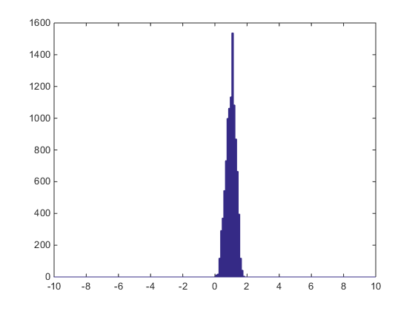
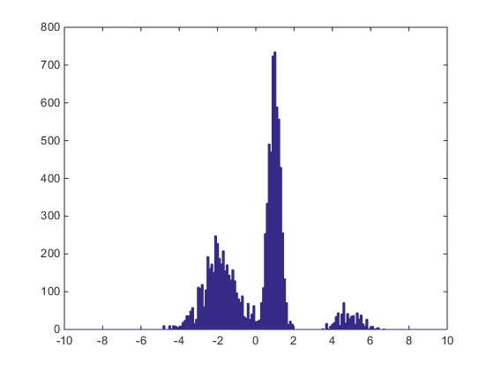
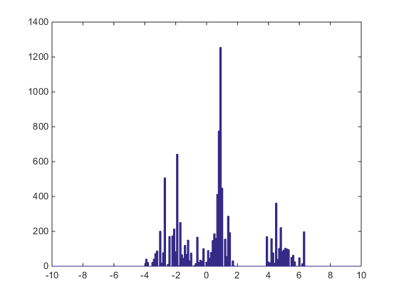
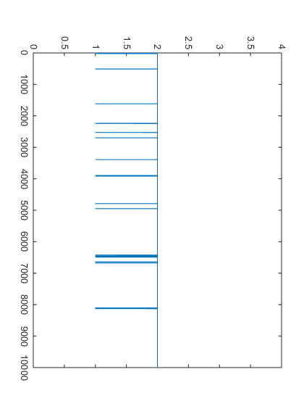
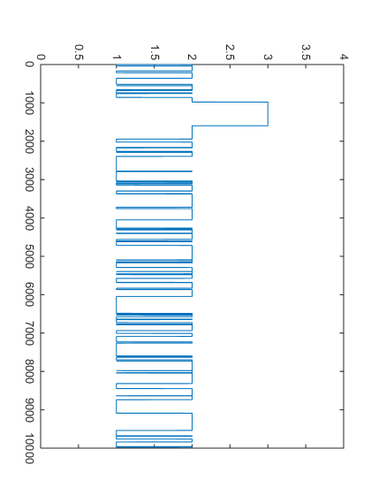
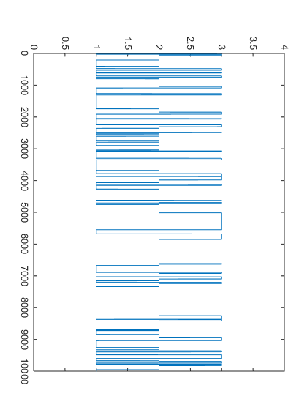
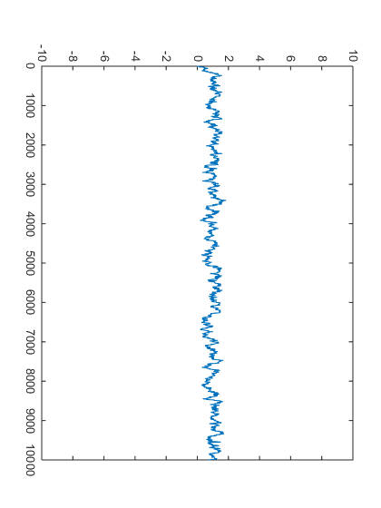
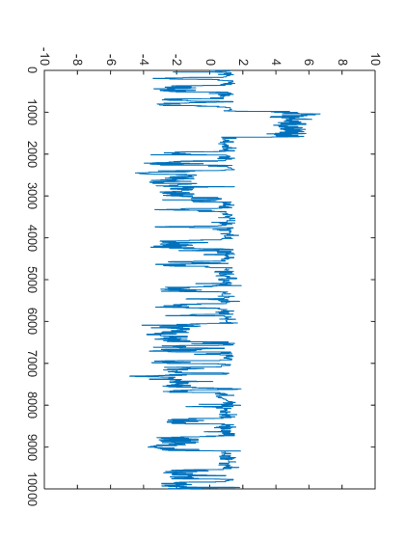
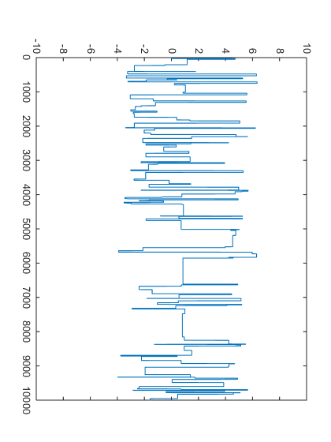
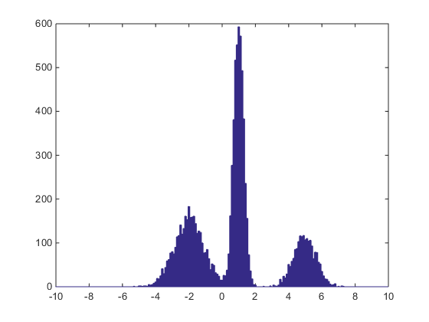

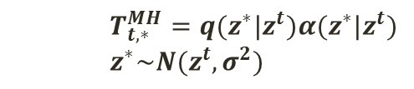


Result of Random Walk M-H
$σ^{2}$=0.1
$σ^{2}$=1
$σ^{2}$=40
Overall Sampling
Sampling Result of
Random Walk M-H
Latent
Mode Selection
Sampling
Observed Variable
Sampling
Target Mixture
Distribution
$$T_{t,∗}^{MH}=q(z^{∗}|z^{t})α(z^{∗}|z^{t})$$
$$z^{∗}\sim N(z^{t},σ^{2})$$

Slide 21
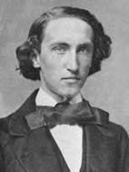
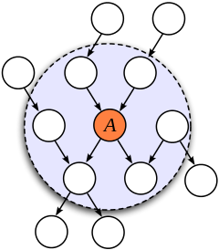
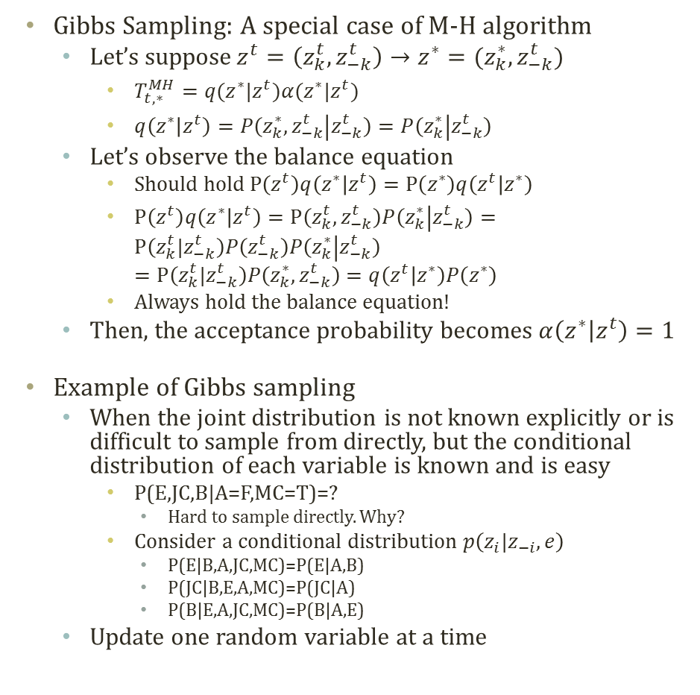
Gibbs Sampling
Josiah Willard Gibbs
(1839 - 1903)
- physicist
Gibbs Sampling: A special case of M-H algorithm
Let’s suppose$z^{t}=\left(z_{k}^{t},z_{−k}^{t}\right)→z^{∗}=(z_{k}^{∗},z_{−k}^{t})$
$T_{t,∗}^{MH}=q(z^{∗}|z^{t})α(z^{∗}|z^{t})$
$q\left(z^{∗} | z^{t}\right)=P\left(z_{k}^{∗},z_{−k}^{t} | z_{−k}^{t}\right)=P\left(z_{k}^{∗} | z_{−k}^{t}\right)$
Let’s observe the balance equation
Should hold $P\left(z^{t}\right)q\left(z^{∗} | z^{t}\right)=P\left(z^{∗}\right)q\left(z^{t} | z^{∗}\right)$
$P\left(z^{t}\right)q\left(z^{∗} | z^{t}\right)=P\left(z_{k}^{t},z_{−k}^{t}\right)P\left(z_{k}^{∗} | z_{−k}^{t}\right)=P\left(z_{k}^{t}|z_{−k}^{t}\right)P\left(z_{−k}^{t}\right)P\left(z_{k}^{∗} | z_{−k}^{t}\right)$ $=P\left(z_{k}^{t}|z_{−k}^{t}\right)P\left(z_{k}^{∗},z_{−k}^{t}\right)=q\left(z^{t} | z^{∗}\right)P\left(z^{∗}\right)$
Always hold the balance equation!
Then, the acceptance probability becomes $α\left(z^{∗} | z^{t}\right)=1$
Example of Gibbs sampling
When the joint distribution is not known explicitly or is difficult to sample from directly, but the conditional distribution of each variable is known and is easy
P(E,JC,B|A=F,MC=T)=?
Hard to sample directly. Why?
Consider a conditional distribution $p\left(z_{i}|z_{−i}, e\right)$
P(E|B,A,JC,MC)=P(E|A,B)
P(JC|B,E,A,MC)=P(JC|A)
P(B|E,A,JC,MC)=P(B|A,E)
Update one random variable at a time
Buglary
Earthquake
Alarm
Can simplify using the Markov blanket
JohnCalls
MaryCalls
Notes:
Bayesian inference : prior posterior

Slide 22

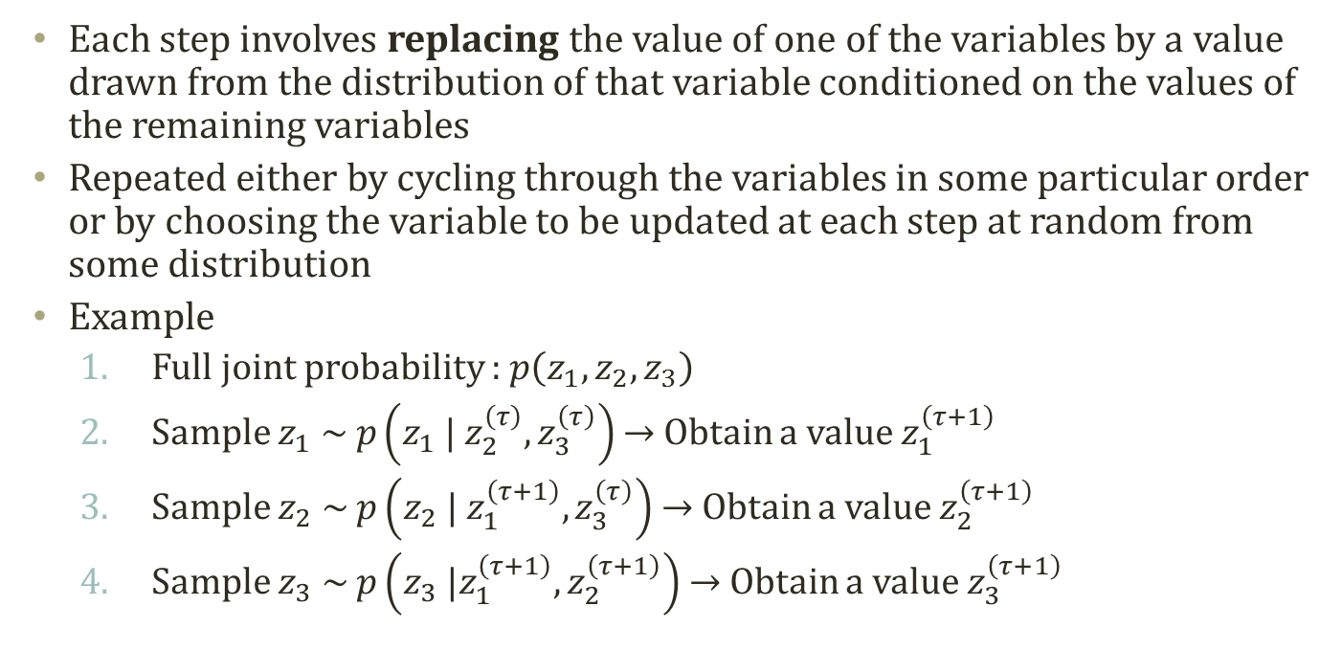



Concept of Gibbs Sampling
Each step involves replacing the value of one of the variables by a value drawn from the distribution of that variable conditioned on the values of the remaining variables
Repeated either by cycling through the variables in some particular order or by choosing the variable to be updated at each step at random from some distribution
Example
Full joint probability : $p\left(z_{1},z_{2},z_{3}\right)$
Sample $z_{1} \sim p\left(z_{1} | z_{2}^{\left(τ\right)},z_{3}^{\left(τ\right)}\right)$ → Obtain a value $z_{1}^{\left(τ+1\right)}$
Sample $z_{2} \sim p\left(z_{2} | z_{1}^{\left(τ+1\right)},z_{3}^{\left(τ\right)}\right)$ → Obtain a value $z_{2}^{\left(τ+1\right)}$
Sample $z_{3} \sim p\left(z_{3} |z_{1}^{\left(τ+1\right)},z_{2}^{\left(τ+1\right)}\right)$ → Obtain a value $z_{3}^{\left(τ+1\right)}$
$$\left\{z_{1}^{\left(τ\right)},z_{2}^{\left(τ\right)},z_{3}^{\left(τ\right)}\right\}$$
$$\left\{z_{1}^{\left(τ+1\right)},z_{2}^{\left(τ\right)},z_{3}^{\left(τ\right)}\right\}$$
$$\left\{z_{1}^{\left(τ+1\right)},z_{2}^{\left(τ+1\right)},z_{3}^{\left(τ\right)}\right\}$$
$$\left\{z_{1}^{\left(τ+1\right)},z_{2}^{\left(τ+1\right)},z_{3}^{\left(τ+1\right)}\right\}$$

Slide 23
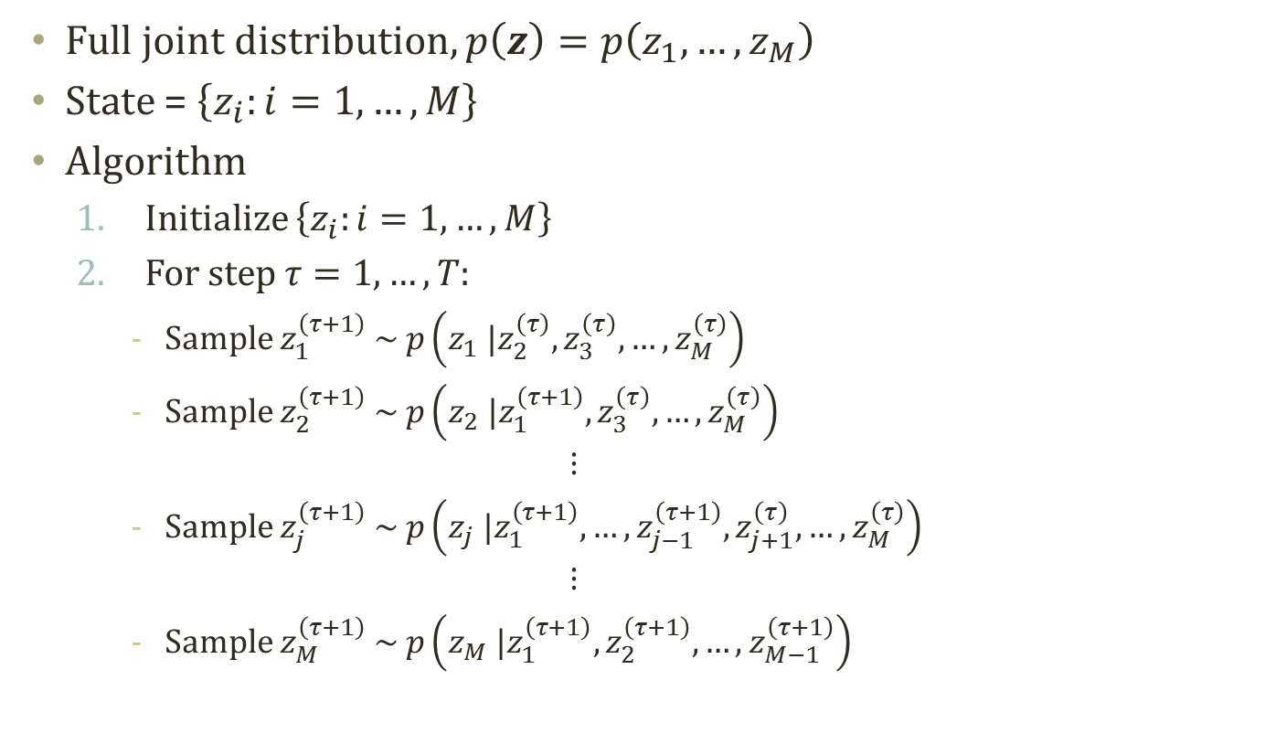
Gibbs Sampling Algorithm
Full joint distribution, $p\left(z\right)=p\left(z_{1},…,z_{M}\right)$
State = $\left\{z_{i}:i=1,…,M\right\}$
Algorithm
Initialize $\left\{z_{i}:i=1,…,M\right\}$
For step $τ=1,…,T:$
Sample $z_{1}^{\left(τ+1\right)} \sim p\left(z_{1} |z_{2}^{\left(τ\right)},z_{3}^{\left(τ\right)},…,z_{M}^{\left(τ\right)}\right)$
Sample $z_{2}^{\left(τ+1\right)} \sim p\left(z_{2} |z_{1}^{\left(τ+1\right)},z_{3}^{\left(τ\right)},…,z_{M}^{\left(τ\right)}\right)$
$$⋮$$
Sample $z_{j}^{\left(τ+1\right)} \sim p\left(z_{j} |z_{1}^{\left(τ+1\right)},…,z_{j−1}^{\left(τ+1\right)},z_{j+1}^{\left(τ\right)},…,z_{M}^{\left(τ\right)}\right)$
$$⋮$$
Sample $z_{M}^{\left(τ+1\right)} \sim p\left(z_{M} |z_{1}^{\left(τ+1\right)},z_{2}^{\left(τ+1\right)},…,z_{M−1}^{\left(τ+1\right)}\right)$

Slide 24
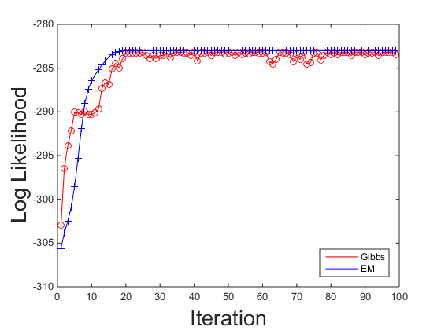
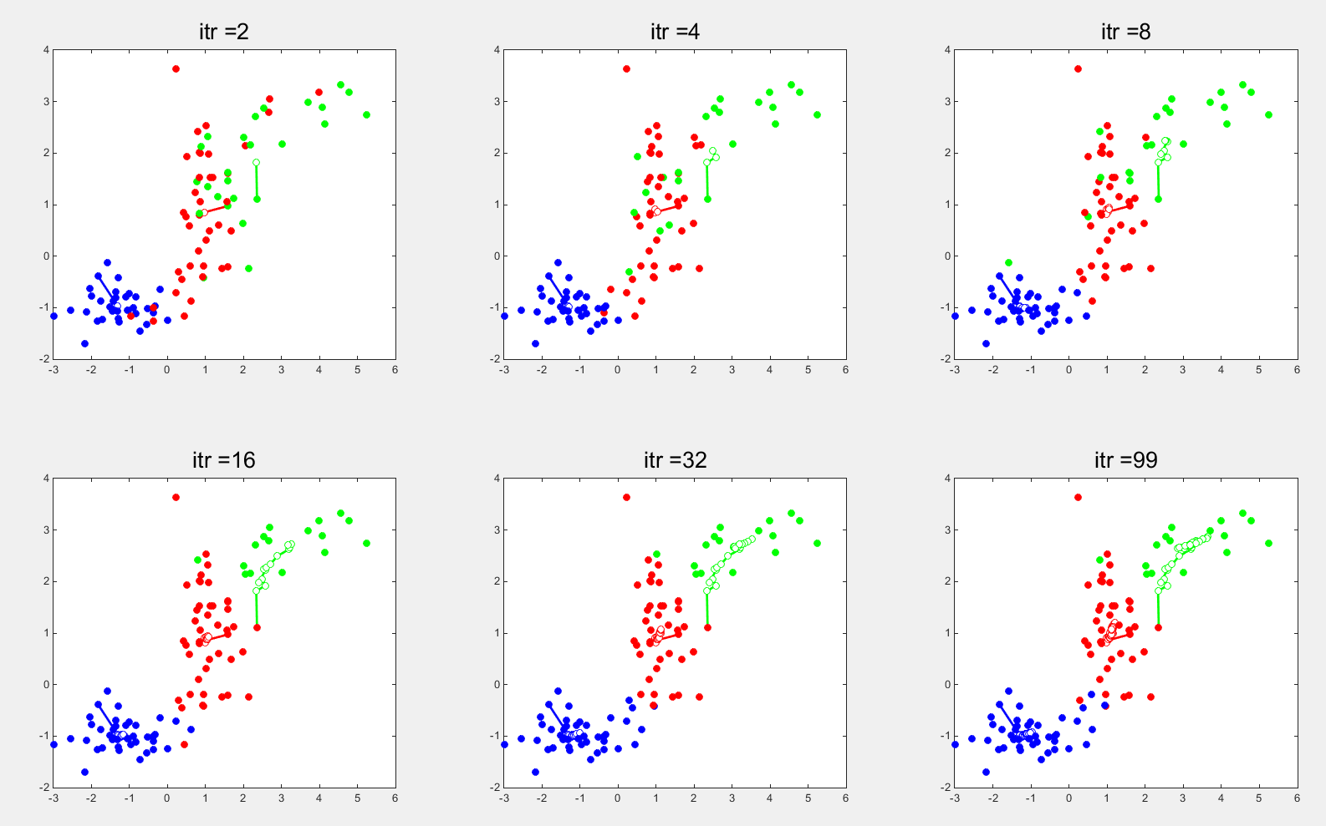
Gibbs Sampling based GMM
Hard to tell the performance with the simple GMM
Sampling based inference
Simulation based
EM based inference
Optimization based
Real power of Gibbs sampler comes from collapsing! → Collapsed Gibbs Sampler
Let’s look at more sophisticated model for collapsing technique

Slide 25
Latent Dirichlet allocation

Slide 26

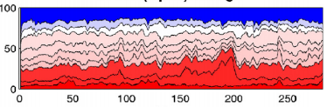
Topic Modeling
Sample results of topic modeling on News paper searched by ‘Obama’
What we can identify are
Topics
The proportion of topics
The most probable words in topics
Text analysis without reading the whole corpus
Days

Slide 27
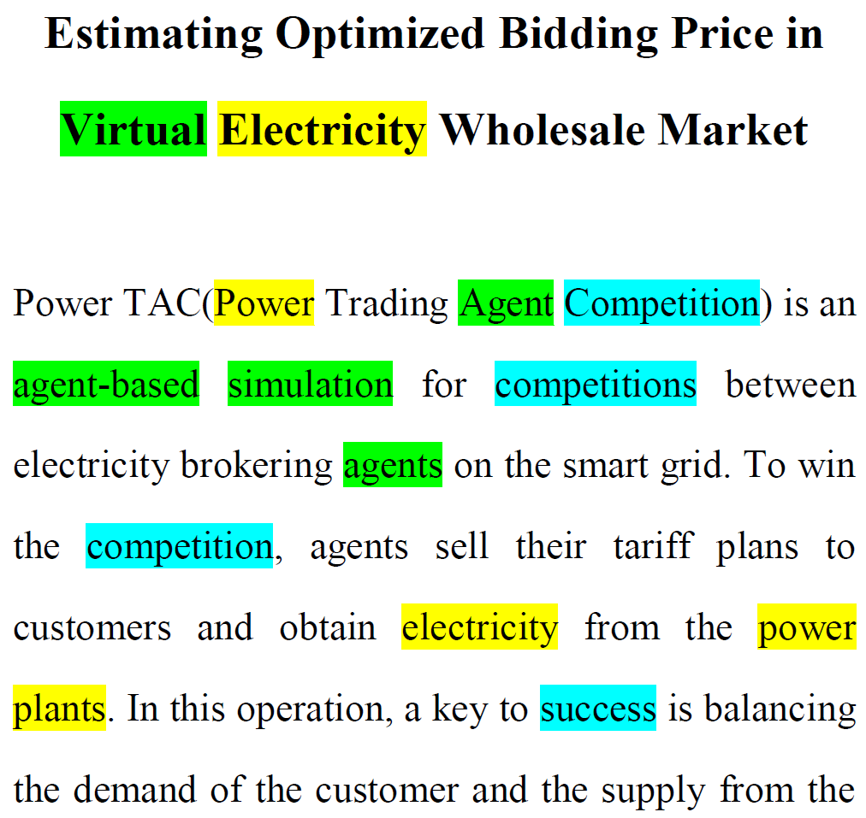
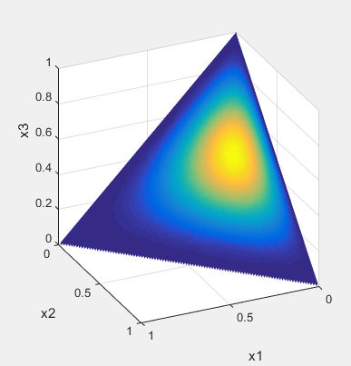






Latent Dirichlet Allocation
Latent Dirichlet Allocation
Soft clustering in text data
Has the structure of text corpus
Is a Bayesian model with priors
For each word $w$, sample topic assignment $z$
$$α$$
$$θ$$
z
w
$$φ$$
$$β$$
N
M
K
Prob.
Topic 1 2 3 $⋯$
Dirichlet Distribution
Prior
Document specific
topic proportion
Topic assignment
Notes:
We shall begin by discussing Bayesian networks, also known as directed graphical models, in which the links of the graphs have a particular directionality indicated by arrows. The other major class of graphical models are Markov random fields, also known as undirected graphical models, in which the links do not carry arrows and have no directional significance.

Slide 28

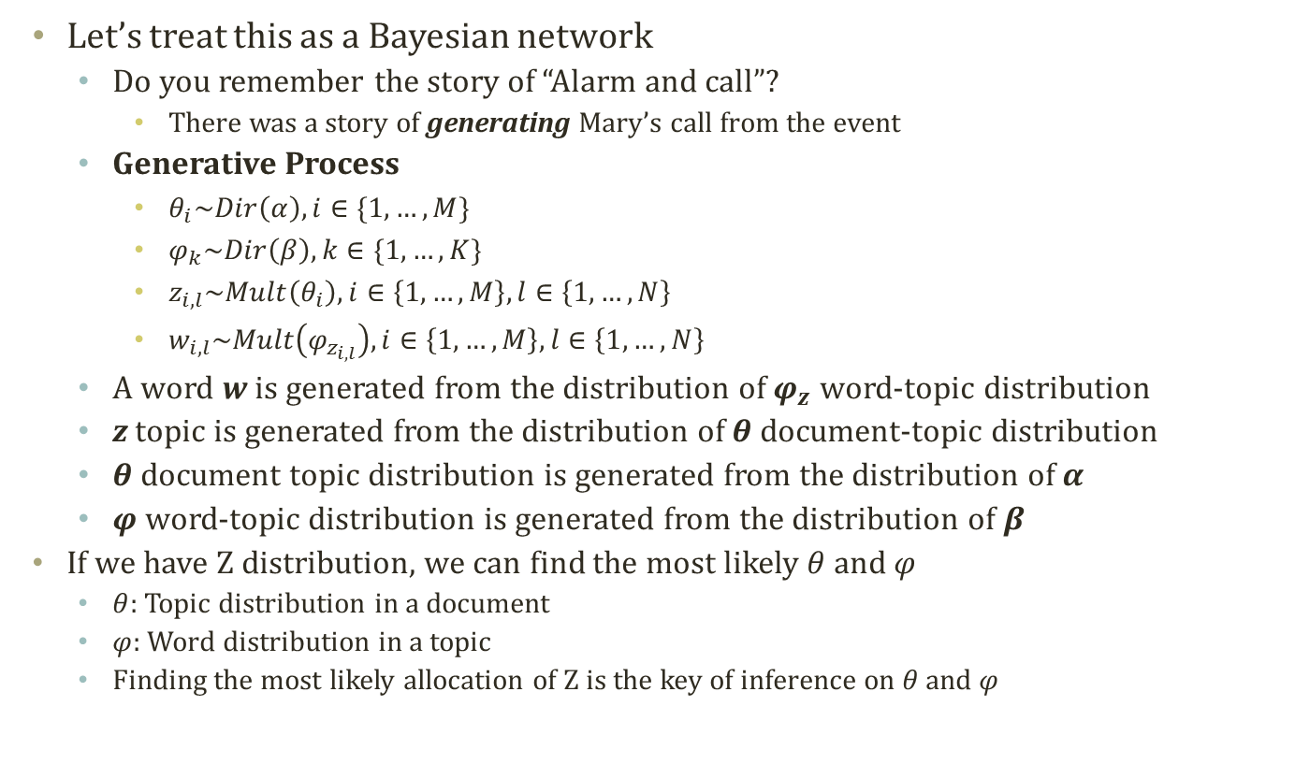



Finding Topic Assignment Per Word
$$α$$
$$θ$$
z
w
$$φ$$
$$β$$
N
M
K
Let’s treat this as a Bayesian network
Do you remember the story of “Alarm and call”?
There was a story of generating Mary’s call from the event
Generative Process
$θ_{i}\sim Dir\left(α\right),i∈\{1,…,M\}$
$φ_{k}\sim Dir\left(β\right),k∈\{1,…,K\}$
$z_{i,l}\sim Mult\left(θ_{i}\right),i∈\left\{1,…,M\right\},l∈\left\{1,…,N\right\}$
$w_{i,l}\sim Mult\left(φ_{z_{i,l}}\right),i∈\left\{1,…,M\right\},l∈\left\{1,…,N\right\}$
A word w is generated from the distribution of $φ_{z}$ word-topic distribution
z topic is generated from the distribution of $θ$ document-topic distribution
$θ$ document topic distribution is generated from the distribution of $α$
$φ$ word-topic distribution is generated from the distribution of $β$
If we have Z distribution, we can find the most likely $θ$ and $φ$
$θ$: Topic distribution in a document
$φ$: Word distribution in a topic
Finding the most likely allocation of Z is the key of inference on $θ$ and $φ$

Slide 29

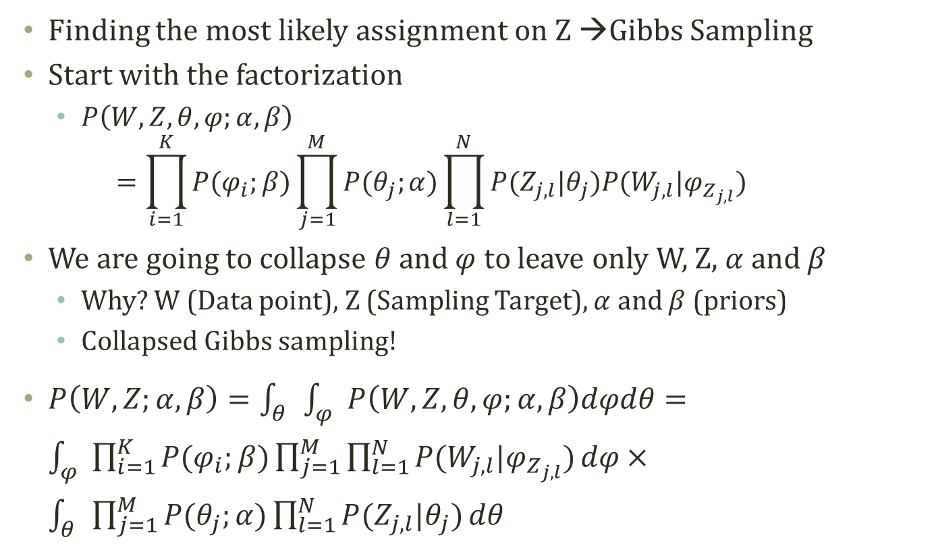



Gibbs Sampling on Z (1)
$$α$$
$$θ$$
z
w
$$φ$$
$$β$$
N
M
K
Finding the most likely assignment on Z →Gibbs Sampling
Start with the factorization
$P\left(W,Z,θ,φ;α,β\right)$ $=\prod_{i=1}^{K}{P(φ_{i};β)}\prod_{j=1}^{M}{P(θ_{j};α)\prod_{l=1}^{N}{P(Z_{j,l}|θ_{j})P(W_{j,l}|φ_{Z_{j,l}})}}$
We are going to collapse $θ$ and $φ$ to leave only W, Z, $α$ and $β$
Why? W (Data point), Z (Sampling Target), $α$ and $β$ (priors)
Collapsed Gibbs sampling!
$P\left(W,Z;α,β\right)=\int_{θ}{\int_{φ}{P\left(W,Z,θ,φ;α,β\right)dφdθ}}=\int_{φ}{\prod_{i=1}^{K}{P(φ_{i};β)\prod_{j=1}^{M}{\prod_{l=1}^{N}{P(W_{j,l}|φ_{Z_{j,l}})}}dφ}}×\int_{θ}{\prod_{j=1}^{M}{P(θ_{j};α)\prod_{l=1}^{N}{P(Z_{j,l}|θ_{j})}}dθ}$
Independence between two integrals
Need to remove the integrals and come up with the sampling distribution
© Wikipedia page on LDA

Slide 30


Gibbs Sampling on Z (2)
$$x\sim Dir\left(α\right)$$
$$P\left(X | α\right)=\frac{Γ(\sum_{i=1}^{K}{α_{i}})}{\prod_{i=1}^{K}{{Γ(α}_{i})}}\prod_{i=1}^{K}{{x_{i}}^{α_{i}−1}}$$
$P\left(W,Z;α,β\right)=\int_{θ}{\int_{φ}{P\left(W,Z,θ,φ;α,β\right)dφdθ}}=\int_{φ}{\prod_{i=1}^{K}{P(φ_{i};β)\prod_{j=1}^{M}{\prod_{l=1}^{N}{P(W_{j,l}|φ_{Z_{j,l}})}}dφ}}×\int_{θ}{\prod_{j=1}^{M}{P(θ_{j};α)\prod_{l=1}^{N}{P(Z_{j,l}|θ_{j})}}dθ}=(1)×(2)$
$\left(1\right)=\int_{φ}{\prod_{i=1}^{K}{P(φ_{i};β)\prod_{j=1}^{M}{\prod_{l=1}^{N}{P(W_{j,l}|φ_{Z_{j,l}})}}dφ}}=\prod_{i=1}^{K}{\int_{φ_{i}}{P(φ_{i};β)\prod_{j=1}^{M}{\prod_{l=1}^{N}{P(W_{j,l}|φ_{Z_{j,l}})}}}dφ_{i}}=\prod_{i=1}^{K}{\int_{φ_{i}}{\frac{Γ(\sum_{v=1}^{V}{β_{v}})}{\prod_{v=1}^{V}{{Γ(β}_{v})}}\prod_{v=1}^{V}{{φ_{i,v}}^{β_{v}−1}}\prod_{j=1}^{M}{\prod_{l=1}^{N}{P(W_{j,l}|φ_{Z_{j,l}})}}}dφ_{i}}$
We introduce a new count of $n_{j,r}^{i}$: number of words assigned to i-th topic in j-th document with r-th unique word
$=\prod_{i=1}^{K}{\int_{φ_{i}}{\frac{Γ(\sum_{v=1}^{V}{β_{v}})}{\prod_{v=1}^{V}{{Γ(β}_{v})}}\prod_{v=1}^{V}{{φ_{i,v}}^{β_{v}−1}}\prod_{v=1}^{V}{{φ_{i,v}}^{n_{\left(.\right),v}^{i}}}}dφ_{i}}$
$=\prod_{i=1}^{K}{\int_{φ_{i}}{\frac{Γ(\sum_{v=1}^{V}{β_{v}})}{\prod_{v=1}^{V}{{Γ(β}_{v})}}\prod_{v=1}^{V}{{φ_{i,v}}^{n_{\left(.\right),v}^{i}+β_{v}−1}}}dφ_{i}}$
=$\prod_{i=1}^{K}{\frac{\prod_{v=1}^{V}{Γ(n_{\left(.\right),v}^{i}+β_{v})}Γ(\sum_{v=1}^{V}{β_{v}})}{\prod_{v=1}^{V}{{Γ(β}_{v})}Γ(\sum_{v=1}^{V}{n_{\left(.\right),v}^{i}+β_{v}})}\int_{φ_{i}}{\frac{Γ(\sum_{v=1}^{V}{n_{\left(.\right),v}^{i}+β_{v}})}{\prod_{v=1}^{V}{Γ(n_{\left(.\right),v}^{i}+β_{v})}}\prod_{v=1}^{V}{{φ_{i,v}}^{n_{\left(.\right),v}^{i}+β_{v}−1}}}dφ_{i}}$
$\text{=}\prod_{i=1}^{K}{\frac{\prod_{v=1}^{V}{Γ(n_{\left(.\right),v}^{i}+β_{v})}Γ(\sum_{v=1}^{V}{β_{v}})}{\prod_{v=1}^{V}{{Γ(β}_{v})}Γ(\sum_{v=1}^{V}{n_{\left(.\right),v}^{i}+β_{v}})}}$
© Wikipedia page on LDA

Slide 31

Gibbs Sampling on Z (3)
$$x\sim Dir\left(α\right)$$
$$P\left(X | α\right)=\frac{Γ(\sum_{i=1}^{K}{α_{i}})}{\prod_{i=1}^{K}{{Γ(α}_{i})}}\prod_{i=1}^{K}{{x_{i}}^{α_{i}−1}}$$
$P\left(W,Z;α,β\right)=\int_{θ}{\int_{φ}{P\left(W,Z,θ,φ;α,β\right)dφdθ}}=\int_{φ}{\prod_{i=1}^{K}{P(φ_{i};β)\prod_{j=1}^{M}{\prod_{l=1}^{N}{P(W_{j,l}|φ_{Z_{j,l}})}}dφ}}×\int_{θ}{\prod_{j=1}^{M}{P(θ_{j};α)\prod_{l=1}^{N}{P(Z_{j,l}|θ_{j})}}dθ}=(1)×(2)$
$\left(2\right)=\int_{θ}{\prod_{j=1}^{M}{P\left(θ_{j};α\right)\prod_{l=1}^{N}{P\left(Z_{j,l} | θ_{j}\right)}}dθ}=\prod_{j=1}^{M}{\int_{θ_{j}}{P\left(θ_{j};α\right)\prod_{l=1}^{N}{P\left(Z_{j,l} | θ_{j}\right)}dθ_{j}}}=\prod_{j=1}^{M}{\int_{θ_{j}}{\frac{Γ(\sum_{k=1}^{K}{α_{k}})}{\prod_{k=1}^{K}{{Γ(α}_{k})}}\prod_{k=1}^{K}{{θ_{j,k}}^{α_{k}−1}}\prod_{l=1}^{N}{P\left(Z_{j,l} | θ_{j}\right)}dθ_{j}}}$
We introduce a new count of $n_{j,r}^{i}$: number of words assigned to i-th topic in j-th document with r-th unique word
$=\prod_{j=1}^{M}{\int_{θ_{j}}{\frac{Γ(\sum_{i=1}^{K}{α_{i}})}{\prod_{i=1}^{K}{{Γ(α}_{i})}}\prod_{i=1}^{K}{{θ_{j,i}}^{α_{i}−1}}\prod_{k=1}^{K}{{θ_{j,k}}^{n_{j,(.)}^{k}}}dθ_{j}}}$
$=\prod_{j=1}^{M}{\int_{θ_{j}}{\frac{Γ(\sum_{i=1}^{K}{α_{i}})}{\prod_{i=1}^{K}{{Γ(α}_{i})}}\prod_{i=1}^{K}{{θ_{j,k}}^{n_{j,(.)}^{i}+α_{k}−1}}dθ_{j}}}$
$=\prod_{j=1}^{M}{\frac{\prod_{i=1}^{K}{{Γ(n_{j,(.)}^{i}+α}_{k})}Γ(\sum_{i=1}^{K}{α_{k}}) }{\prod_{i=1}^{K}{{Γ(α}_{i})}Γ(\sum_{i=1}^{K}{n_{j,(.)}^{i}+α_{k}})}\int_{θ_{j}}{\frac{Γ(\sum_{i=1}^{K}{n_{j,(.)}^{i}+α_{k}})}{\prod_{i=1}^{K}{{Γ(n_{j,(.)}^{i}+α}_{k})}}\prod_{i=1}^{K}{{θ_{j,i}}^{n_{j,(.)}^{i}+α_{k}−1}}dθ_{j}}}$
$=\prod_{j=1}^{M}{\frac{\prod_{i=1}^{K}{{Γ(n_{j,(.)}^{i}+α}_{i})}Γ(\sum_{i=1}^{K}{α_{i}}) }{\prod_{i=1}^{K}{{Γ(α}_{i})}Γ(\sum_{i=1}^{K}{n_{j,(.)}^{i}+α_{i}})}}$
© Wikipedia page on LDA

Slide 32

Collapse from Conjugacy
Same mechanism to remove $θ$ and $φ$
=$\prod_{i=1}^{K}{\frac{\prod_{v=1}^{V}{Γ(n_{\left(.\right),v}^{i}+β_{v})}Γ(\sum_{v=1}^{V}{β_{v}})}{\prod_{v=1}^{V}{{Γ(β}_{v})}Γ(\sum_{v=1}^{V}{n_{\left(.\right),v}^{i}+β_{v}})}\int_{φ_{i}}{\frac{Γ(\sum_{v=1}^{V}{n_{\left(.\right),v}^{i}+β_{v}})}{\prod_{v=1}^{V}{Γ(n_{\left(.\right),v}^{i}+β_{v})}}\prod_{v=1}^{V}{{φ_{i,v}}^{n_{\left(.\right),v}^{i}+β_{v}−1}}}dφ_{i}}$
$=\prod_{j=1}^{M}{\frac{\prod_{i=1}^{K}{{Γ(n_{j,(.)}^{i}+α}_{k})}Γ(\sum_{i=1}^{K}{α_{k}}) }{\prod_{i=1}^{K}{{Γ(α}_{i})}Γ(\sum_{i=1}^{K}{n_{j,(.)}^{i}+α_{k}})}\int_{θ_{j}}{\frac{Γ(\sum_{i=1}^{K}{n_{j,(.)}^{i}+α_{k}})}{\prod_{i=1}^{K}{{Γ(n_{j,(.)}^{i}+α}_{k})}}\prod_{i=1}^{K}{{θ_{j,i}}^{n_{j,(.)}^{i}+α_{k}−1}}dθ_{j}}}$
This is a multiplication of the Dirichlet distribution and the multinomial distribution. After multiplication, another Dirichlet distribution emerges.
In LDA: i.e. $\int_{θ}{\prod_{j=1}^{M}{P(θ_{j};α)\prod_{l=1}^{N}{P(Z_{j,l}|θ_{j})}}dθ}$
In general: $P(X|θ)×P(θ)$
Likelihood and prior multiplication results in the prior distribution → Conjugate prior
LDA utilizes the multinomial distribution and the Dirichlet distribution
Dirichlet distribution is the conjugate prior of the multinomical distribution
Enables sum to one technique!

Slide 33

Gibbs Sampling Formula (1)
$P\left(W,Z;α,β\right)=\prod_{i=1}^{K}{\frac{\prod_{v=1}^{V}{Γ(n_{\left(.\right),v}^{i}+β_{v})}Γ(\sum_{v=1}^{V}{β_{v}})}{\prod_{v=1}^{V}{{Γ(β}_{v})}Γ(\sum_{v=1}^{V}{n_{\left(.\right),v}^{i}+β_{v}})}}\prod_{j=1}^{M}{\frac{\prod_{i=1}^{K}{{Γ(n_{j,(.)}^{i}+α}_{i})}Γ(\sum_{i=1}^{K}{α_{i}}) }{\prod_{i=1}^{K}{{Γ(α}_{i})}Γ(\sum_{i=1}^{K}{n_{j,(.)}^{i}+α_{i}})}}$
Here, W, $α$ and $β$ are assumed or data-points, and Z is the target of sampling.
Gibbs sampling iterates the element of Z, one by one.
Therefore, we need to derive a formula of a single element Z when all other element of Z, W, $α$ and $β$ are given.
$P\left(Z_{\left(m,l\right)}=k | Z_{−\left(m,l\right)},W;α,β\right)=\frac{P\left(Z_{\left(m,l\right)}=k,Z_{−\left(m,l\right)},W;α,β\right)}{P(Z_{−\left(m,l\right)},W;α,β)}$ $∝P\left(Z_{\left(m,l\right)}=k,Z_{−\left(m,l\right)},W;α,β\right)$
$Z_{\left(m,l\right)}$ is the topic assignment on the l-th word of m-th document
$$\left\{z_{1}^{\left(τ\right)},z_{2}^{\left(τ\right)},z_{3}^{\left(τ\right)}\right\}$$
$$\left\{z_{1}^{\left(τ+1\right)},z_{2}^{\left(τ\right)},z_{3}^{\left(τ\right)}\right\}$$
$$\left\{z_{1}^{\left(τ+1\right)},z_{2}^{\left(τ+1\right)},z_{3}^{\left(τ\right)}\right\}$$
$$\left\{z_{1}^{\left(τ+1\right)},z_{2}^{\left(τ+1\right)},z_{3}^{\left(τ+1\right)}\right\}$$

Slide 34

Gibbs Sampling Formula (2)
$P\left(W,Z;α,β\right)=\prod_{i=1}^{K}{\frac{\prod_{v=1}^{V}{Γ(n_{\left(.\right),v}^{i}+β_{v})}Γ(\sum_{v=1}^{V}{β_{v}})}{\prod_{v=1}^{V}{{Γ(β}_{v})}Γ(\sum_{v=1}^{V}{n_{\left(.\right),v}^{i}+β_{v}})}}\prod_{j=1}^{M}{\frac{\prod_{i=1}^{K}{{Γ(n_{j,(.)}^{i}+α}_{i})}Γ(\sum_{i=1}^{K}{α_{i}}) }{\prod_{i=1}^{K}{{Γ(α}_{i})}Γ(\sum_{i=1}^{K}{n_{j,(.)}^{k}+α_{i}})}}$
$={(\frac{Γ(\sum_{v=1}^{V}{β_{v}})}{\prod_{v=1}^{V}{{Γ(β}_{v})}})}^{K}{(\frac{Γ(\sum_{i=1}^{K}{α_{i}})}{\prod_{i=1}^{K}{{Γ(α}_{i})}})}^{M}\prod_{i=1}^{K}{\frac{\prod_{v=1}^{V}{Γ(n_{\left(.\right),v}^{i}+β_{v})}}{Γ(\sum_{v=1}^{V}{n_{\left(.\right),v}^{i}+β_{v}})}}\prod_{j=1}^{M}{\frac{\prod_{i=1}^{K}{{Γ(n_{j,(.)}^{i}+α}_{i})} }{Γ(\sum_{i=1}^{K}{n_{j,(.)}^{i}+α_{i}})}}$
$∝\prod_{i=1}^{K}{\frac{\prod_{v=1}^{V}{Γ(n_{\left(.\right),v}^{i}+β_{v})}}{Γ(\sum_{v=1}^{V}{n_{\left(.\right),v}^{i}+β_{v}})}}\prod_{j=1}^{M}{\frac{\prod_{i=1}^{K}{{Γ(n_{j,(.)}^{i}+α}_{i})} }{Γ(\sum_{i=1}^{K}{n_{j,(.)}^{i}+α_{i}})}}$
Now, apply that $P\left(Z_{\left(m,l\right)}=k,Z_{−\left(m,l\right)},W;α,β\right)$
$∝\prod_{i=1}^{K}{\frac{\prod_{v=1}^{V}{Γ(n_{\left(.\right),v}^{i}+β_{v})}}{Γ(\sum_{v=1}^{V}{n_{\left(.\right),v}^{i}+β_{v}})}}×\frac{\prod_{i=1}^{K}{{Γ(n_{m,(.)}^{i}+α}_{i})} }{Γ(\sum_{i=1}^{K}{n_{m,(.)}^{i}+α_{i}})}$: Fixing document by m
$∝\prod_{i=1}^{K}{\frac{Γ(n_{\left(.\right),v}^{i}+β_{v})}{Γ(\sum_{r=1}^{V}{n_{\left(.\right),r}^{i}+β_{r}})}}×\frac{\prod_{i=1}^{K}{{Γ(n_{m,(.)}^{i}+α}_{i})} }{Γ(\sum_{i=1}^{K}{n_{m,(.)}^{i}+α_{i}})}$: Fixing word by l
$∝\prod_{i=1}^{K}{\frac{Γ(n_{\left(.\right),v}^{i}+β_{v})}{Γ(\sum_{r=1}^{V}{n_{\left(.\right),r}^{i}+β_{r}})}}×\prod_{i=1}^{K}{{Γ(n_{m,(.)}^{i}+α}_{i})}$: Remove a constant $Γ(\sum_{i=1}^{K}{n_{m,(.)}^{i}+α_{i}})$

Slide 35

Gibbs Sampling Formula (3)
$P\left(Z_{\left(m,l\right)}=k | Z_{−\left(m,l\right)},W;α,β\right)∝P\left(Z_{\left(m,l\right)}=k,Z_{−\left(m,l\right)},W;α,β\right)$
$∝\prod_{i=1}^{K}{\frac{Γ(n_{\left(.\right),v}^{i}+β_{v})}{Γ(\sum_{r=1}^{V}{n_{\left(.\right),r}^{i}+β_{r}})}}×\prod_{i=1}^{K}{{Γ(n_{m,(.)}^{i}+α}_{k})}$
Now, we set $n_{j,r}^{i,−(m,l)}$ as $n_{j,r}^{i}$ excluding the count from the topic assignment of $Z_{\left(m,l\right)}$
$∝\prod_{i=1,i≠k}^{K}{\frac{Γ\left(n_{\left(.\right),v}^{i,−\left(m,n\right)}+β_{v}\right)}{Γ\left(\sum_{r=1}^{V}{n_{\left(.\right),r}^{i,−\left(m,n\right)}+β_{r}}\right)}}×\prod_{i=1,i≠k}^{K}{{Γ(n_{m,\left(.\right)}^{i,−\left(m,n\right)}+α}_{k})}$ $×\frac{Γ\left(n_{\left(.\right),v}^{k,−\left(m,n\right)}+β_{v}+1\right)}{Γ\left((\sum_{r=1}^{V}{n_{\left(.\right),r}^{k,−\left(m,n\right)}+β_{r}})+1\right)}×{Γ(n_{m,\left(.\right)}^{k,−\left(m,n\right)}+α}_{k}+1)$
Take out the k-th topic assignment because, the count of the k-th topic assignment count will be increased by 1 compared to $n_{(.),(.)}^{k,−(m,l)}$
Notice the increment of 1 in the separated multiplication
$∝\prod_{i=1,i≠k}^{K}{\frac{Γ\left(n_{\left(.\right),v}^{i,−\left(m,n\right)}+β_{v}\right)}{Γ\left(\sum_{r=1}^{V}{n_{\left(.\right),r}^{i,−\left(m,n\right)}+β_{r}}\right)}}×\prod_{i=1,i≠k}^{K}{{Γ(n_{m,\left(.\right)}^{i,−\left(m,n\right)}+α}_{k})}$ $×\frac{Γ\left(n_{\left(.\right),v}^{k,−\left(m,n\right)}+β_{v}\right)}{Γ\left(\sum_{r=1}^{V}{n_{\left(.\right),r}^{k,−\left(m,n\right)}+β_{r}}\right)}×{Γ(n_{m,\left(.\right)}^{k,−\left(m,n\right)}+α}_{k})$ $×\frac{n_{\left(.\right),v}^{k,−\left(m,n\right)}+β_{v}}{(\sum_{r=1}^{V}{n_{\left(.\right),r}^{k,−\left(m,n\right)}+β_{r}})}×{(n_{m,\left(.\right)}^{k,−\left(m,n\right)}+α}_{k})$
Definition of $Γ\left(x\right)=\left(x−1\right)!$
Therefore, $Γ\left(x+1\right)=\left(x\right)!×x$

Slide 36

Gibbs Sampling Formula (4)
$P\left(Z_{\left(m,l\right)}=k | Z_{−\left(m,l\right)},W;α,β\right)∝P\left(Z_{\left(m,l\right)}=k,Z_{−\left(m,l\right)},W;α,β\right)$
$∝\prod_{i=1,i≠k}^{K}{\frac{Γ\left(n_{\left(.\right),v}^{i,−\left(m,n\right)}+β_{v}\right)}{Γ\left(\sum_{r=1}^{V}{n_{\left(.\right),r}^{i,−\left(m,n\right)}+β_{r}}\right)}}×\prod_{i=1,i≠k}^{K}{{Γ(n_{m,\left(.\right)}^{i,−\left(m,n\right)}+α}_{k})}$ $×\frac{Γ\left(n_{\left(.\right),v}^{k,−\left(m,n\right)}+β_{v}\right)}{Γ\left(\sum_{r=1}^{V}{n_{\left(.\right),r}^{k,−\left(m,n\right)}+β_{r}}\right)}×{Γ(n_{m,\left(.\right)}^{k,−\left(m,n\right)}+α}_{k})$ $×\frac{n_{\left(.\right),v}^{k,−\left(m,n\right)}+β_{v}}{(\sum_{r=1}^{V}{n_{\left(.\right),r}^{k,−\left(m,n\right)}+β_{r}})}×{(n_{m,\left(.\right)}^{k,−\left(m,n\right)}+α}_{k})$
$∝\prod_{i=1 }^{K}{\frac{Γ\left(n_{\left(.\right),v}^{i,−\left(m,n\right)}+β_{v}\right)}{Γ\left(\sum_{r=1}^{V}{n_{\left(.\right),r}^{i,−\left(m,n\right)}+β_{r}}\right)}}×\prod_{i=1}^{K}{{Γ(n_{m,\left(.\right)}^{i,−\left(m,n\right)}+α}_{k})}$ $×\frac{n_{\left(.\right),v}^{k,−\left(m,n\right)}+β_{v}}{(\sum_{r=1}^{V}{n_{\left(.\right),r}^{k,−\left(m,n\right)}+β_{r}})}×{(n_{m,\left(.\right)}^{k,−\left(m,n\right)}+α}_{k})$
Absolved the i=k case in to the large operator of multiplications
The topic assignment count used for the large multiplication is same to the assignment of any k on the word assignment of $Z_{\left(m,l\right)}$
Therefore, only the meaningful proportion is the separated single multiplications
$P\left(Z_{\left(m,l\right)}=k | Z_{−\left(m,l\right)},W;α,β\right)∝\frac{n_{\left(.\right),v}^{k,−\left(m,n\right)}+β_{v}}{(\sum_{r=1}^{V}{n_{\left(.\right),r}^{k,−\left(m,n\right)}+β_{r}})}×{(n_{m,\left(.\right)}^{k,−\left(m,n\right)}+α}_{k})$
Finally, this formula is simplified enough to calculate the likelihood of assigning k to $Z_{\left(m,l\right)}$
To become a probability, we need to normalize the above formula.

Slide 37

LDA Model Parameter Inference Routine with Gibbs
LDA(TextCorpus T, $α,β$)
Randomly, initialize Z assignment on T
Count $n_{j,r}^{i}$ with the initial Z assignment
While performance measure (i.e. perplexity) converges
For m = 1 to T’s document number
For l = 1 to T_{m}’s document word length
Sampling k from $P\left(Z_{\left(m,l\right)}=k | Z_{−\left(m,l\right)},W;α,β\right)∝\frac{n_{\left(.\right),v}^{k,−\left(m,n\right)}+β_{v}}{(\sum_{r=1}^{V}{n_{\left(.\right),r}^{k,−\left(m,n\right)}+β_{r}})}×{(n_{m,\left(.\right)}^{k,−\left(m,n\right)}+α}_{k})$
Adjust $n_{j,r}^{i}$ by assigning $Z_{\left(m,l\right)}=k$
Calculate the most likely estimation on $θ$ and $φ$
Return $θ$ and $φ$
Note
$θ$ represents the document-topic probability
$φ$ represents the topic-word probability
Perplexity is the measurement on the quality of the soft-clustering, and calculating it may take some time. Hence, many cases, we just set the iteration number.

